Slide 1

Taught By:
Daniel Opoku (Ph.D.)
EE 288 (ELECTRICAL) MEASUREMENT
& INSTRUMENTATION
CONTACT
c/o:
Address: Department of Electrical Engineering
KNUST, Kumasi, Ghana
E-mail: dopoku.csoe@knust.edu.gh
Phone: 0553604143
Office: Opposite COE Department (Temp)
Semester 2, 2016/2017

Slide 2
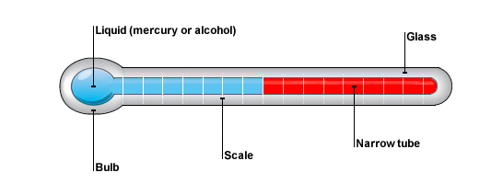
Systems of Measurement
Measuring system: arrangement of components that provides information about the physical value of some variable being measured.
Can consist of only a single unit that gives an output reading or signal according to the magnitude of the unknown variable applied to it.
Source: http://www.bbc.co.uk/

Slide 3
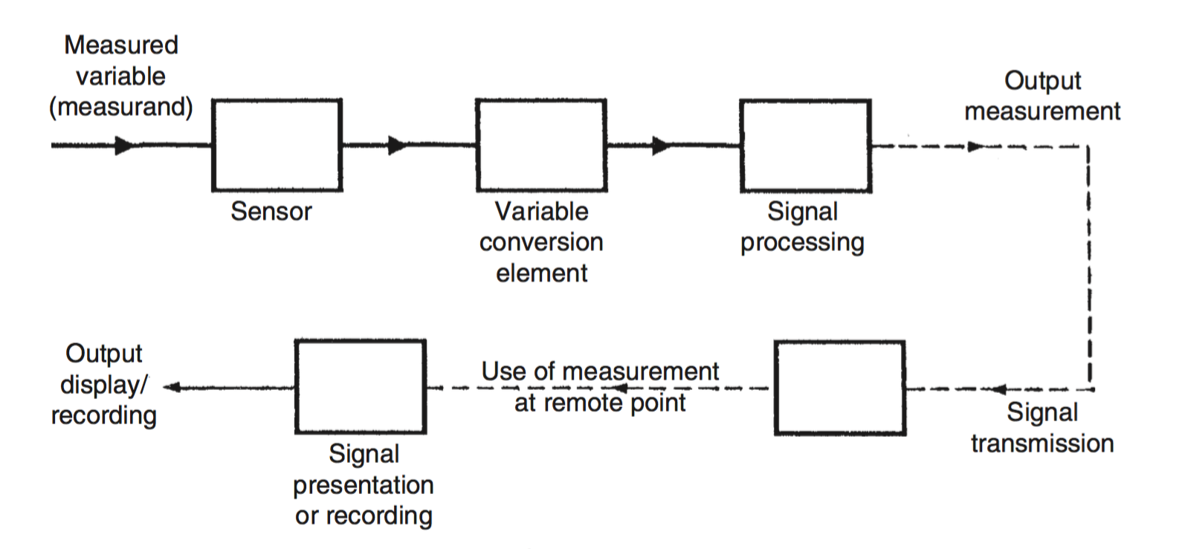
Systems of Measurement
Measuring System can also consists of several separate elements
These components might be contained within one or more boxes,
The boxes holding individual measurement elements might be either close together or physically separate.

Slide 4
Systems of Measurement
Measuring instrument: describe a measurement system, whether it contains only one or many elements.
Instrumentation: Instrumentation is the design, selection and application of measuring instruments for measurement, observation and/or control of processes.
Instrumentation engineering is the branch of engineering that specializes on the principle and operation of measuring instruments.

Slide 5
Systems of Measurement
Control/Instrumentation engineers are personnel responsible for the design, develop, installation, and/or maintaining equipment measuring instruments.
Instrumentation Techniques and Instruments evolve all the time, thus a good instrumentation engineer must read appropriate technical journals regularly.
Notes:
Computer Lecture 1 Ended Monday 22/1/2018

Slide 6
Systems of Measurement
The Sensor gives an output that is a function of the measuring (quantity being measured)
E.g. liquid-in-glass thermometer, a thermocouple, and a strain gauge.

Slide 7
Systems of Measurement
The Variable Conversion Elements converts the output to a more useable form for a given application.
E.g. Bridge Circuit for converting a strain gauges resistance to a change in voltage.
A combination of the Sensor and the Variable Conversion Element form a Transducer.

Slide 8
Systems of Measurement
The Signal processing elements is used to improve the quality of the output of the measurement system.
E.g. Electronic Amplifier: improves the sensitivity and resolution of measurement;
Filters for reducing induced noise in the output.

Slide 9
Systems of Measurement
The Signal Transmission is used to transmit the measurement output to a ‘remote’ location.
E.g. Single or multicored cable, fiber-optic cables, wireless media such as GSM, Blue Tooth, etc.

Slide 10
Systems of Measurement
Signal Receiving Unit
The Signal Presentation or Recording Unit is used to display the measurement output.

Slide 11
Choosing Appropriate Measuring Instruments
To choose a most suitable instrument for measuring a particular quantity, start with the characteristics required
Desired Parameters: Measurement accuracy, resolution, sensitivity, and dynamic performance.
Environment Conditions the instrument will be subjected to.
May necessitate protection for the instrument.
Protecting/Shielding may reduce the performance of the instrument.
Choose measurement system or instrument that is as insensitive as possible to the prevailing environmental conditions.
Other considerations: durability, maintainability, and constancy of performance to ensure long time operation without performance degradation

Slide 12
Choosing Appropriate Measuring Instruments
To choose a most suitable instrument for measuring a particular quantity, start with the characteristics required
Desired Parameters: Measurement accuracy, resolution, sensitivity, and dynamic performance.
Environment Conditions the instrument will be subjected to.
May necessitate protection for the instrument.
Protecting/Shielding may reduce the performance of the instrument.
Choose measurement system or instrument that is as insensitive as possible to the prevailing environmental conditions.

Slide 13
Choosing Appropriate Measuring Instruments
Other considerations: durability, maintainability, and constancy of performance to ensure long time operation without performance degradation
Increasing performance usually comes at a production cost. Thus it is appropriate to start with the minimum required performance and then searching catalogue for instruments that match that.
Do not pay more than necessary by selecting instrument with characteristics superior to the minimum required performance.

Slide 14
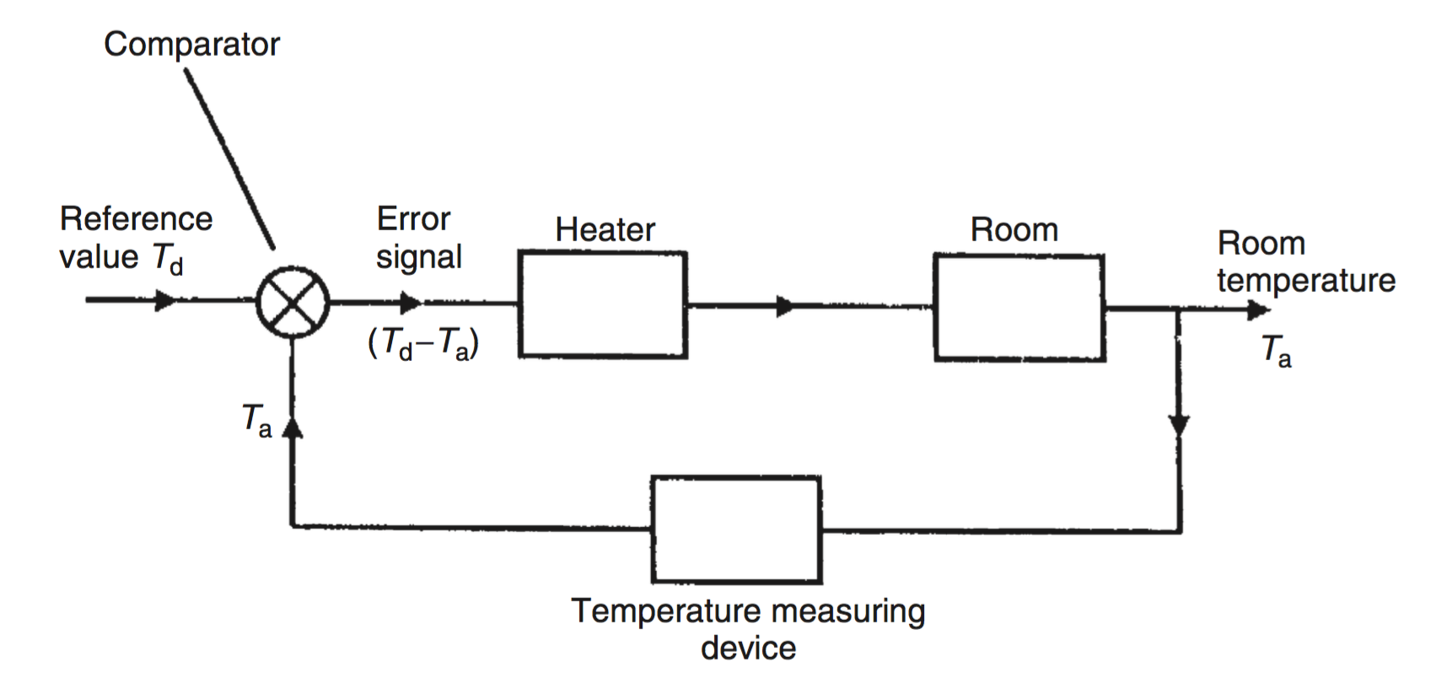
Applications of Measurement Systems
Regulating/Quantification: Measuring quantities for trade, production, etc.
Monitoring: Measuring to determine when to put on the heat or put of the heater.
Control: Such as in automatic feedback control systems.

Slide 15
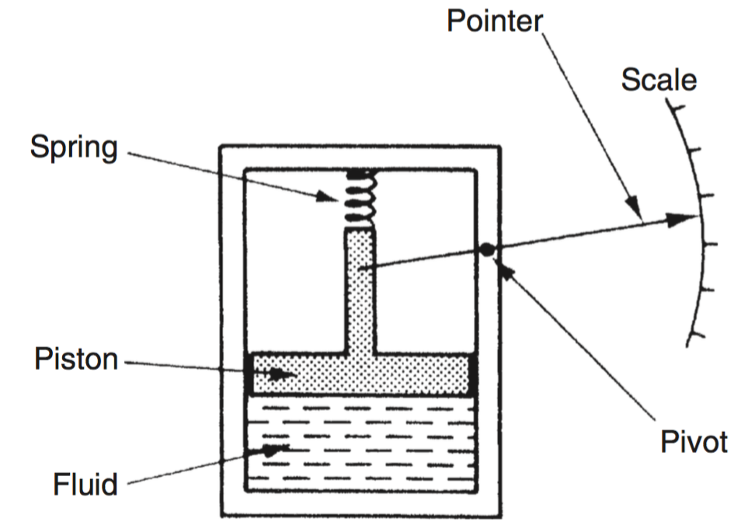
Instrument Types and Performance Characteristics
[Active and Passive Instruments]
Passive Instruments: Output is produced entirely by the quantity being measured.
E.g. Pressure Gauge: Pressure of the fluid is translated into movement of a pointer against a scale.
The pointer movement is derived entirely from the change in pressure.
Usually Simple in their construction and thus cheap compared to their active counterparts.
Other examples: MERCURY-IN-GLASS THERMOMETER,
Notes:
Computer 2nd Lecture ended here. Continue from this slide.

Slide 16
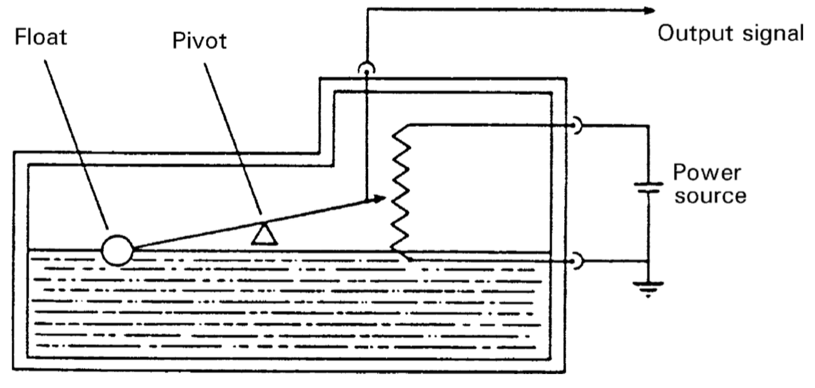
Instrument Types and Performance Characteristics
[Active and Passive Instruments]
Active Instruments: The quantity being measured modulates an external power source.
E.g. float-type petrol tank level indicator: Change in petrol level moves a potentiometer arm; output signal consists of a proportion of the external voltage source applied across the two ends of the potentiometer.
The energy of the output comes entirely from an external source which is modulated by the transducer float system.
The external power source is usually in electrical form, but can also be pneumatic or hydraulic.
Active Instruments usually have high sensitivity and resolution compared to their passive counterparts.

Slide 17
Instrument Types and Performance Characteristics
[Null-Type and Deflection-Type Instruments]
Deflection-Type: The magnitude of the quantitate being measured is indicated by a deflection on a scale.
E.g. Pressure Gauge: Pressure of the fluid is translated into movement of a pointer against a scale.
Accuracy depends on the linearity and calibration of the spring.
Deflection-type instrument are more convenient to use.
The instrument of choice for workplace applications

Slide 18
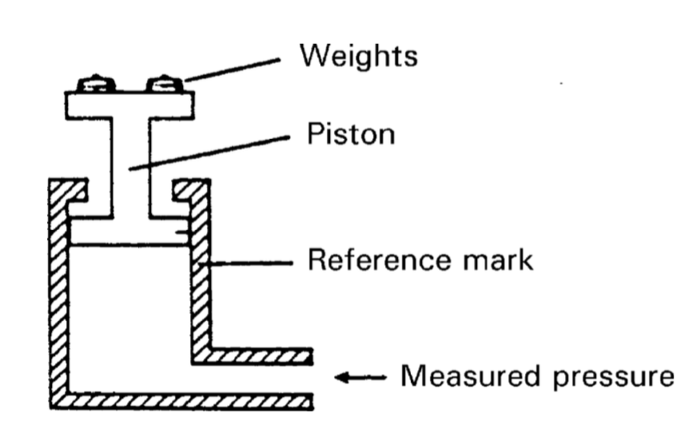
Instrument Types and Performance Characteristics
[Null-Type and Deflection-Type Instruments]
Null-Type: A zero or null gives an indication of the magnitude of the quantity being measure.
E.g. Dead-weight gauge: Weight is placed on the piston until the downward force balances the fluid pressure; Until the piston reaches a null-point.
The measurement is then taken as the amount of weight that was added.
Accuracy depends on on calibration of the weights.
Normally more accurate because weight selection and calibration is easier than the spring calibration.
The instrument of choice for calibration purposes.

Slide 19
Instrument Types and Performance Characteristics
[Analogue and Digital Instruments]
Analogue: The output varies continuously with changes in the quantity being measured.
Thus, it has infinite values within the range of the instrument.
E.g. Pressure Gauge: As the pressure changes, the pointer moves continuously on the scale.
However, the number of positions that the eyes can discriminate is finite.

Slide 20
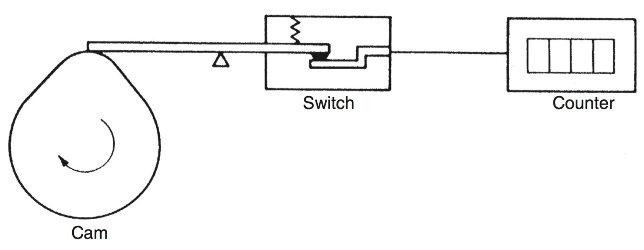
Instrument Types and Performance Characteristics
[Analogue and Digital Instruments]
Digital Instruments: The output varies in a finite discrete steps.
E.g. The revolution counter: The attached Cam closes a circuit/switch after one revolution and the counter counts the output.
Only full revolutions can be counted.
Rapid growth in microprocessor application to automate processes makes digital instruments very important -> Direct interfacing with control system computer.
NB: Analogue instruments can be interface with digital computers through Analogue-to-Digital (A/D) Converters.
Adding A/D can make your system costly, slow, erroneous.
Reading of Analogue indicating instruments are usually prone to errors than Digital.

Slide 21
Instrument Types and Performance Characteristics
[Indicating Instruments and Instruments with a Signal Output ]
Indicating Instruments: Gives a visual or audio indication of the magnitude of the measured quantity.
All null-type and most passive instruments
Can have an analogue or digital outputs
Human intervention is needed to read the instruments and/or record the output.
Reading of Analogue indicating instruments are usually prone to errors than Digital.
E.g. Liquid in glass thermometer and Bathroom Scale exist in both Analogue and Digital forms.
Instruments with a Signal Output: Gives an output signal that is proportional to the magnitude of the measured quantity.
More suitable for automatic control systems or where automatic recording for later utilization.
Output signal usually electrical voltage. Others include Current, Optical or Pneumatic Signal.

Slide 22
Instrument Types and Performance Characteristics
[Smart and Non-smart Instruments ]
Smart Instruments: Incorporate a micro-processor.
Non-Smart Instruments: Do not incorporate a microprocessor.

Slide 23
Static Characteristics of Instruments
[Intro]
A thermometer indicating a room temperature of 20^0
Does not matter if the ‘True temperature’ is 19.5^0 or 20.5^0 because such small difference doesn't not affect us.
Our senses cannot discriminate between such close levels of temperature. A thermometer of accuracy +/- 0.50.5 is thus adequate for our measurement.
However, if the measurement of a certain chemical process is required, then 0.5^0 can significantly affect the rate of reaction
Thus, a temperature with accuracy of +/- 0.5 will not be relevant.

Slide 24
Static Characteristics of Instruments
[Intro]
When measuring the supply voltage of 220V to a motor,
A +/- 0.5V variation might not be harmful; thus a voltmeter with accuracy of +/- 0.5 V will be sufficient for that application.
However, for an electronic circuit, a +/- 0.5 V variation might cause an undesirable effect.
Thus a Voltmeter with accuracy of +/- 0.5 is not sufficient for such application.

Slide 25
Static Characteristics of Instruments
[Intro]
Static characteristics: These are concerned only with the steady-state reading that the instrument settles
Required Accuracy of measurement for a particular application is thus one consideration in the choice of instrument.
Other parameters to consider include sensitivity, linearity, and the reaction to environmental conditions of temperature, vibration and shocks, humidity, chemicals, etc.
These parameters are collectively referred to us Static Characteristics of the Instrument; They are usually stated in the data sheet for the instrument by the manufacturer.
The specifications quoted in such data sheets are only applicable under some specific standard calibration conditions
When the operation conditions are different, due allowance must be made and sometimes, recalibration is necessary.

Slide 26
Static Characteristics of Instruments
[Intro]
Calibration/Recalibration: is the process of adjusting the instrument at each point in its output range until its output readings are the same as those of a second standard instrument to which the same inputs are applied.

Slide 27
Static Characteristics of Instruments
[Accuracy and Inaccuracy (Measurement Uncertainty) ]
Accuracy: The closeness of the output reading of the instrument to the correct (‘actual’ or ‘true’) value of the quantity being measured.
Uncertainty or Inaccuracy: The extent to which the measurement may be wrong.
It is usually quoted as a percentage of full scale reading of the instrument.
This implies measuring quantities which are significantly less than the full scale reading of the instrument can have an amplified measurement error.
Instrument choice for an application therefore should take into consideration the spread of the values to be measured.
The range should be appropriate for the spread of measurements.
To measure a voltage of 0.0V to 1.0V, an instrument of range 0.0V to 10.0V is not a good choice.
In practice, Uncertainty/Inaccuracy is frequently used instead of Accuracy.

Slide 28
Static Characteristics of Instruments
[Accuracy and Inaccuracy (Measurement Uncertainty) ]
Example L2.1: A voltmeter with a measurement range of 0–10 Volts has a quoted inaccuracy of +/- 1.0% f.s. (+/- 1% of full-scale reading). (a) What is the maximum measurement error expected for this instrument? (b) What is the likely measurement error expressed as a percentage of the output reading if this Voltmeter is measuring a Voltage of 1 Volt?
Solution: (a) The maximum error expected in any measurement reading is 1.0% of the full-scale reading, which is 10 Volts for this particular instrument. Hence, the maximum likely error is 1.0%x10 Volts =0.1 Volts. (b) The maximum measurement error is a constant value related to the full-scale reading of the instrument, irrespective of the magnitude of the quantity that the instrument is actually measuring. In this case, as worked out earlier, the magnitude of the error is 0.1 Volts. Thus, when measuring a Voltage of 1 Volts, the maximum possible error of 0.1 Volt is 10% of the measurement value.
(c) Since the maximum value is 10 Volt, it will be 1.0%.

Slide 29
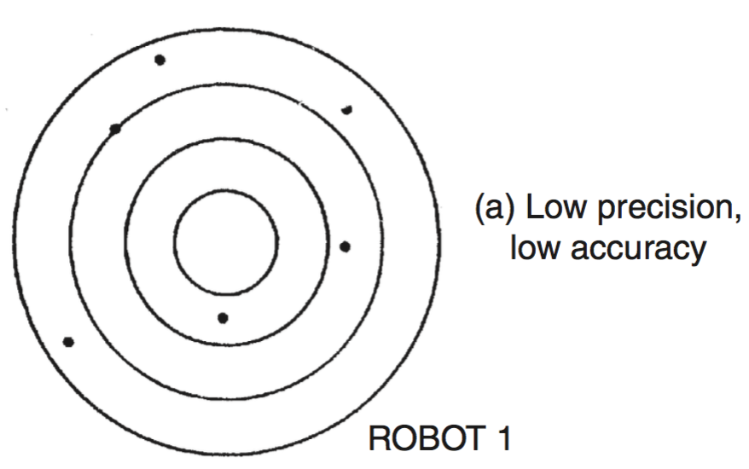
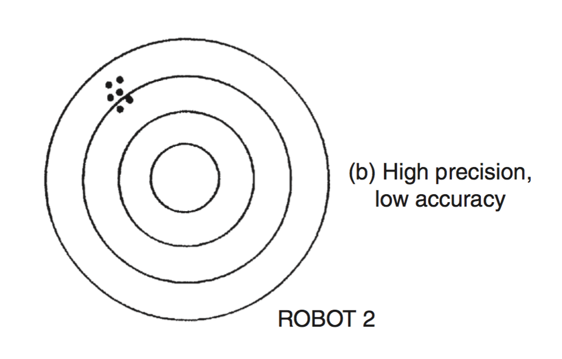
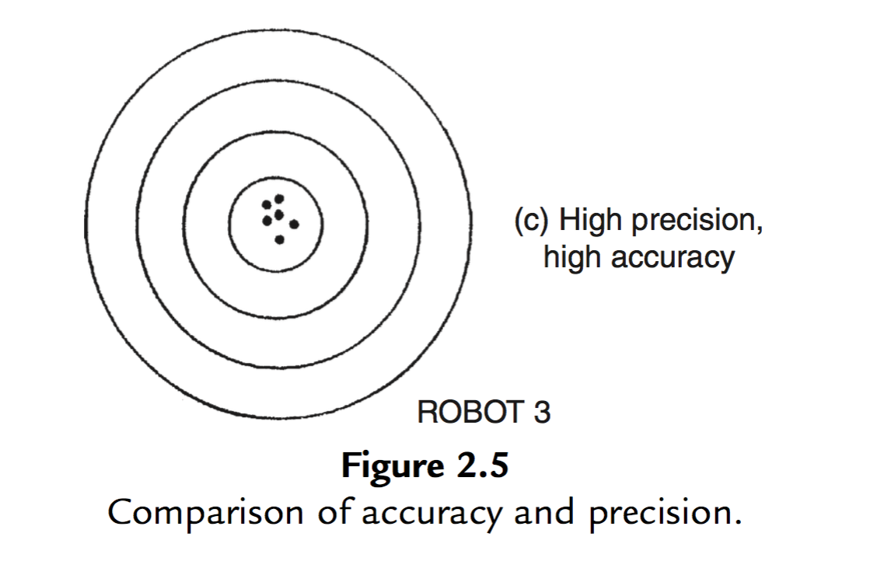
Static Characteristics of Instruments
[Precision/Repeatability/Reproducibility]
Precision: The instruments degree of freedom from random errors.
Large number of readings taken of the same quantity by a high-precision instrument will have a very small spread of readings
High precision does not imply anything about measurement accuracy.
A high-precision instrument may have a low accuracy.
Low accuracy measurements from a high-precision instrument are normally caused by a bias in the measurements, which is removable by recalibration.
Precision can be described in terms of Repeatability or Reproducibility

Slide 30
Static Characteristics of Instruments
[Accuracy Verses Precision]
Repeatability: The closeness of output readings when the same input is applied repetitively over a short period of time, with the same measurement conditions, same instrument and observer, same location, and same conditions of use maintained throughout.
Reproducibility: The closeness of output readings for the same input when there are changes in the method of measurement, observer, measuring instrument, location, conditions of use, and time of measurement.
Both repeatability and Reproducibility describe the spread of measurements for the same quantity.

Slide 31
Static Characteristics of Instruments
[Tolerance]
Tolerance: The maximum error that is to be expected or acceptable in some value.
Tolerance is closely related to accuracy
Accuracy of some instruments are sometimes quoted in terms of tolerance.
In it correct Usage: Tolerance describes the maximum deviation of a manufactured component from some specified value.
That is, tolerance is not in strict terms a static characteristic of an instrument.
E.g. An electric circuit components such as resistors can have tolerances of 5%.

Slide 32
Static Characteristics of Instruments
[Tolerance]
Example L2.1. A packet of resistors bought in an electronics component shop gives the nominal resistance value as 1000 O and the manufacturing tolerance as `5%. If one resistor is chosen at random from the packet, what is the minimum and maximum resistance value that this particular resistor is likely to have?
Solution: The minimum likely value is 1000 Ohms – (5% of 1000 Ohms)= 950 Ohms. The maximum likely value is 1000 Ohms + (5% of 1000 Ohms)= 1050 Ohms.

Slide 33
Static Characteristics of Instruments
[Range and Span]
Range: The region between the minimum and the maximum values that the instrument is capable of measuring or is designed to measure.
Span: The algebraic difference between the minimum and the maximum values that the instrument is capable of measuring or is designed to measure.
i.e. The algebraic difference between the Upper Range Value (URV) and the Lower Range Value (LRV).
The minimum range value is also called the the Zero
E.g. 0 to 150 Ohms, the range is 0 to 150 Ohms, 0 for the 0%(4mA) and 150 for the 100%(20mA), the span is 150 Ohms
20 to 200 Ohms, the range is 20 to 200 Ohms, 20 for the 0%(4mA) and 200 for the 100%(20mA), the span is 180 Ohms
- 40 to 200 deg F, the range is -40 to 200 deg F, 20 for the 0%(4mA) and 200 for the 100%(20mA), the span is 240 Ohms.

Slide 34
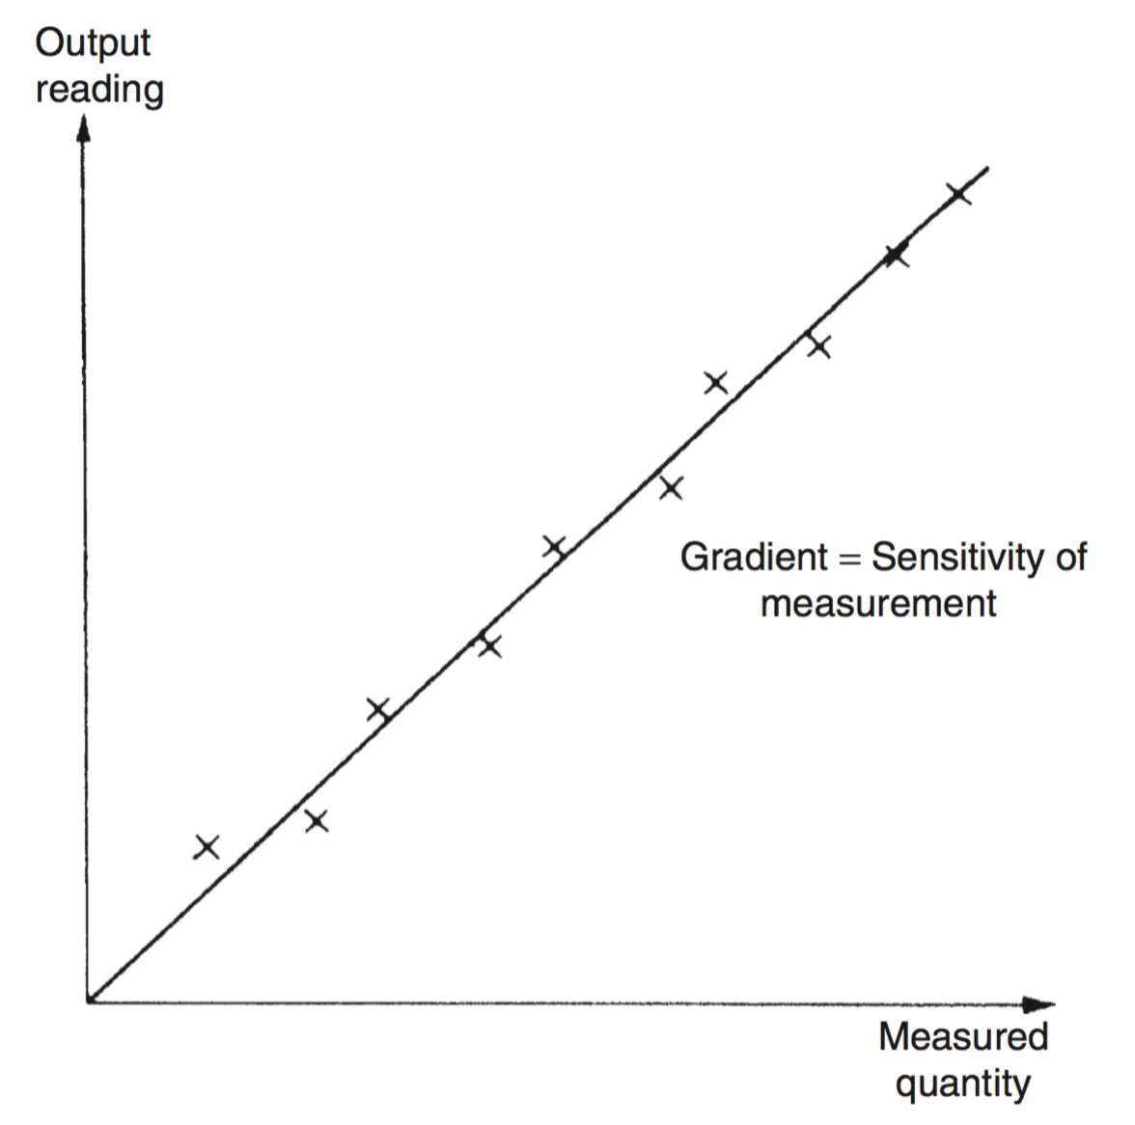
Static Characteristics of Instruments
[Linearity/Non-Linearity]
Linearity: How close the input - output relationship of an instrument is to a linear function.
Non-Linearity: It is more common specified in terms of Non-Linearity.
To quantify the non-linearity, a scatter plot the output verses input as shown.
Use a line fitting algorithm (e.g. least-squares line-fitting technique) to draw a good fit straight line to the plot.
The non-linearity is the maximum deviation of the measurements from the line-of-best-fit (a.k.a. ’trend’ line).

Slide 35
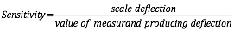

Static Characteristics of Instruments
[Sensitivity/Scale Factor]
Sensitivity: The measure of the change in the output of the instrument produced by a unit change in the input quantity being measured. i.e.
Example L2.3 : The following resistance values of a platinum resistance thermometer were measured at a range of temperatures. Determine the measurement sensitivity of the instrument in ohms/ C.
Resistance (Ohms) | Temperature ( C)
307 | 200
314 | 230
321 | 260
328 | 290

Slide 36
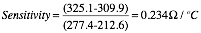
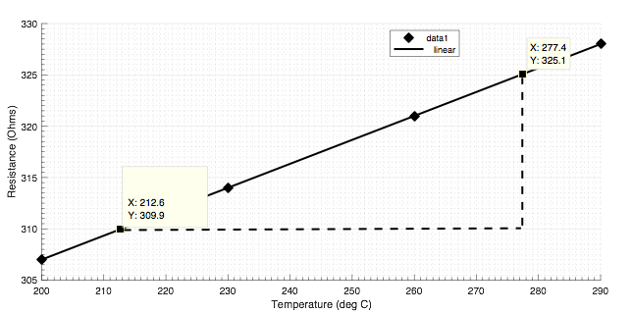
Static Characteristics of Instruments
[Sensitivity/Scale Factor]
Solution:
A scatter plot shows a straight-line relationship between resistance change and temperature change is obvious.
From the graph,

Slide 37
Static Characteristics of Instruments
[Threshold ]
Threshold: The minimum level of input after which the change in the instrument output reading is of a large enough magnitude to be detectable.
Usually quoted as absolute value or percentage of full scale reading.
Assume that the tolerance of a voltmeter is 0.05 V. This means that when being used to measure a variable voltage source, any rise in the input from 0 but less than 0.05V will not be observed at the output until the value reaches 0.05V.

Slide 38
Static Characteristics of Instruments
[Resolution ]
Resolution : The minimum value of the input measured quantity that produces an observable change in the output.
Maybe specified as absolute value or percentage of full scale deflection of the instrument.
For analogue, this is determined by the subdivisions of the output scale.
For example, if the scale of a voltmeter is subdivided into 1Volts. The we cannot reasonable estimate speed more accurate than 0.25 V.

Slide 39
Static Characteristics of Instruments
[Sensitivity to Disturbance]
The specifications for instruments are valid under certain calibration conditions of temperature, pressure, etc.
These standard/calibration ambient conditions are usually specified in the data sheet or user manual by the manufacturer.Variations in the standard conditions can produce variation in the static characteristics of the instrument.
Sensitivity to disturbance: This is the measure of the magnitude of a change in the static characteristic of the instrument caused by a change in ‘disturbance’.
Environmental changes can introduce zero drift or sensitivity drift.

Slide 40
Static Characteristics of Instruments
[Sensitivity to Disturbance]
Zero drift (a.k.a. Bias): A shift in the zero reading caused by a change in the ambient condition.
Causes a constant error over full range of the measurement.
Thus, when there is no input, the output is different from zero.
Zero drift is usually removed by calibration.
Zero drift can be stated in terms of the zero drift coefficient such as V/deg C. A 0.005V/deg C coefficient means that a 1 degree Celsius change in temperature will produce a bias of 0.005 Volts at the output.
If the instrument is sensitive to many environmental conditions, then it will have many zero drift coefficients.

Slide 41
Static Characteristics of Instruments
[Sensitivity to Disturbance]
Sensitivity drift (also known as scale factor drift) : Amount by which the instruments sensitivity varies with the change in ambient conditions.
Specified as a sensitivity drift coefficient (The amount of change in sensitivity caused by a unit change in ambient conditions).
An instrument can suffer both sensitivity and zero drift at the same time.

Slide 42
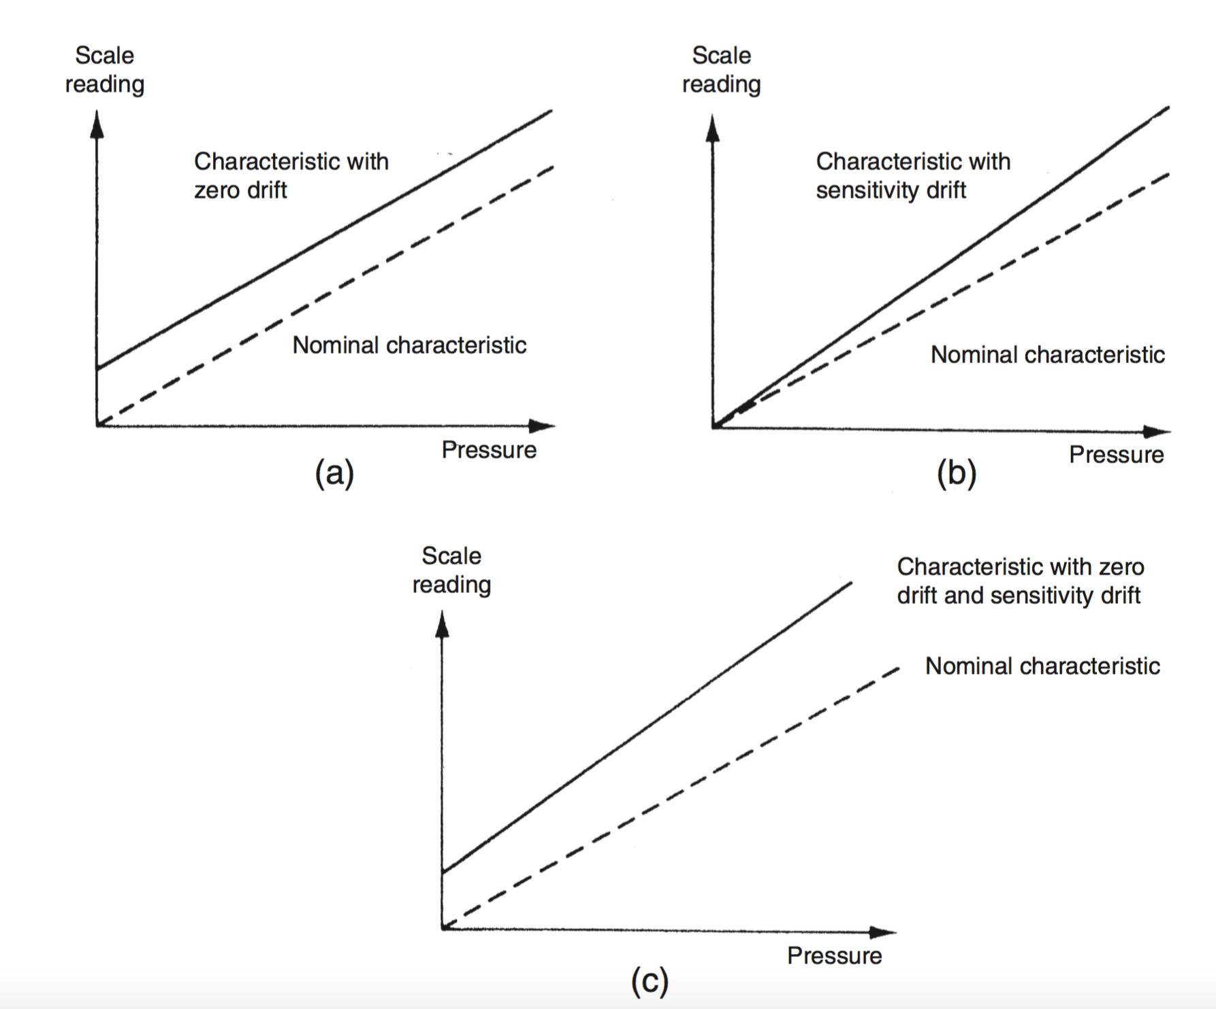
Static Characteristics of Instruments
[Sensitivity to Disturbance]
Effects of disturbance: (a) zero drift, (b) sensitivity drift, and (c) zero drift plus sensitivity drift.

Slide 43
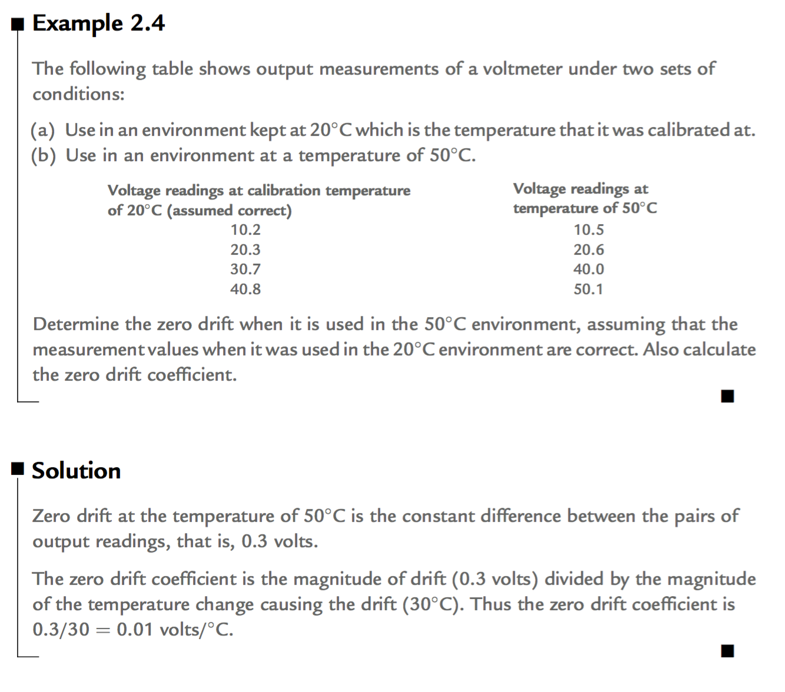
Static Characteristics of Instruments
[Sensitivity to Disturbance]
Example L2. 4

Slide 44
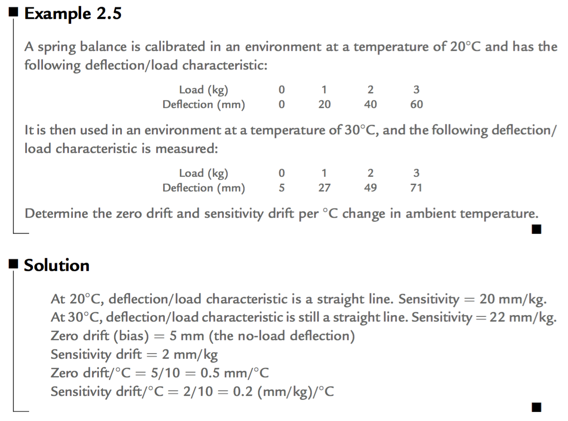
Static Characteristics of Instruments
[Sensitivity to Disturbance]
Example L2. 5

Slide 45
Quiz 1 (6 mins)
1. A load cell is calibrated in an environment at a temperature of 21ºC and has the following deflection/load characteristic:
Load (kg) 0 50 100 150 200
Deflection (mm) 0.0 1.0 2.0 3.0 4.0
When used in an environment at 35ºC, its characteristic changes to the following:
Load (kg) 0 50 100 150 200
Deflection (mm) 0.2 1.3 2.4 3.5 4.6
(a) Determine the sensitivity at 21ºC and 35ºC.
(b) Calculate the total zero drift and sensitivity drift at 35ºC.
(c) Hence determine the zero drift and sensitivity drift coefficients (in units of mm/ºC and (mm per kg)/(ºC).

Slide 46
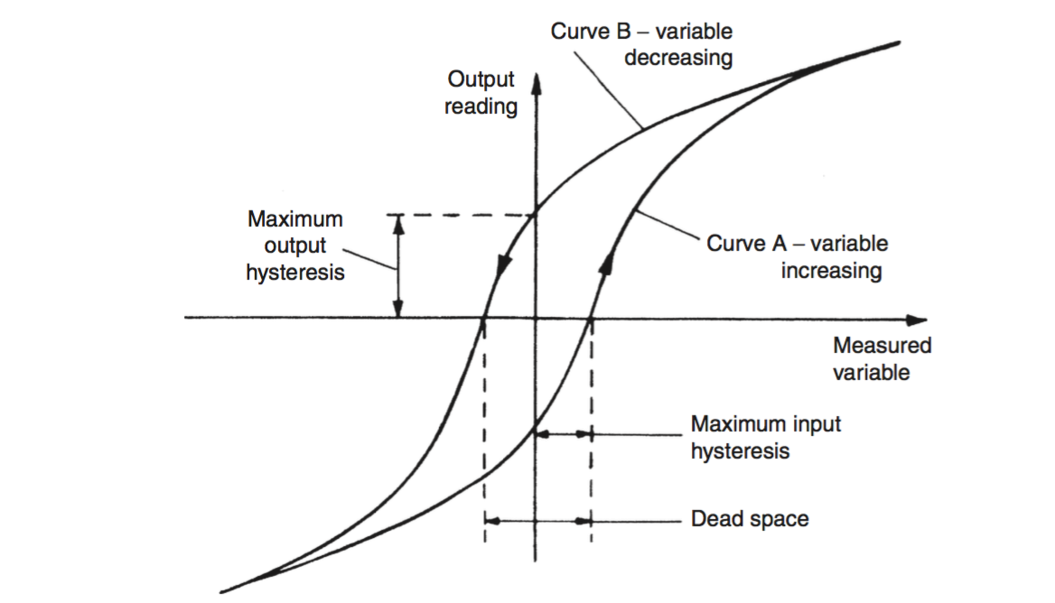
Static Characteristics of Instruments
[Hysteresis Effects and Dead Space]
When the input of the measurement is increased steadily from it LRV to its URV (Loading), the output characteristics curve usually varies from that produced by decreasing the input steadily from the URV to the LRV.
Hysteresis: The non-coincidence between the loading and unloading curves of an instrument.
Hysteresis is usually quantified as the maximum input hysteresis and a maximum output hysteresis.
Hysteresis can occur in instruments with
Springs (e.g. passive pressure gauge and a Prony brake (used for measuring torque))
variable friction due to direction ()
Electrical winding formed round iron core (e.g. inductance displacement transducer, the linear variable differential transformer, and the rotary differential transformer)
Notes:
Computer Lecture 3 ended here.

Slide 47
Static Characteristics of Instruments
[Hysteresis Effects and Dead Space]
Dead Space: Dead space is defined as the range of different input values over which there is no change in output value.
Any instrument that exhibit hysteresis also has dead space but some instruments which do not exhibit hysteresis have dead space.

Slide 48
Static Characteristics of Instruments
[Dynamic Characteristics]
Dynamic Characteristics of an instruments: behavior between the time a measured quantity changes value and the time when the instrument output attains a steady value in response.
Dynamic Characteristics quoted in the data sheet and its valid for the specific environmental conditions.
When the environmental conditions change, there can be variations in the dynamic characteristics as well.
For a linear, time-invariant measuring system, the general relation between input and output for time (t) > 0 is:

Slide 49
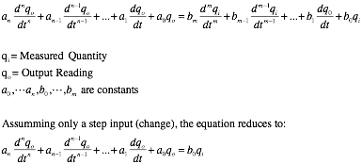
Static Characteristics of Instruments
[Dynamic Characteristics]
For a linear, time-invariant measuring system, the general relation between input and output for time (t) > 0 is:
Will consider three special cases namely: Zero-Order Instrument, First-Order Instrument, Second-Order Instrument

Slide 50
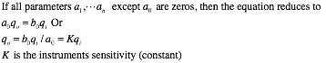
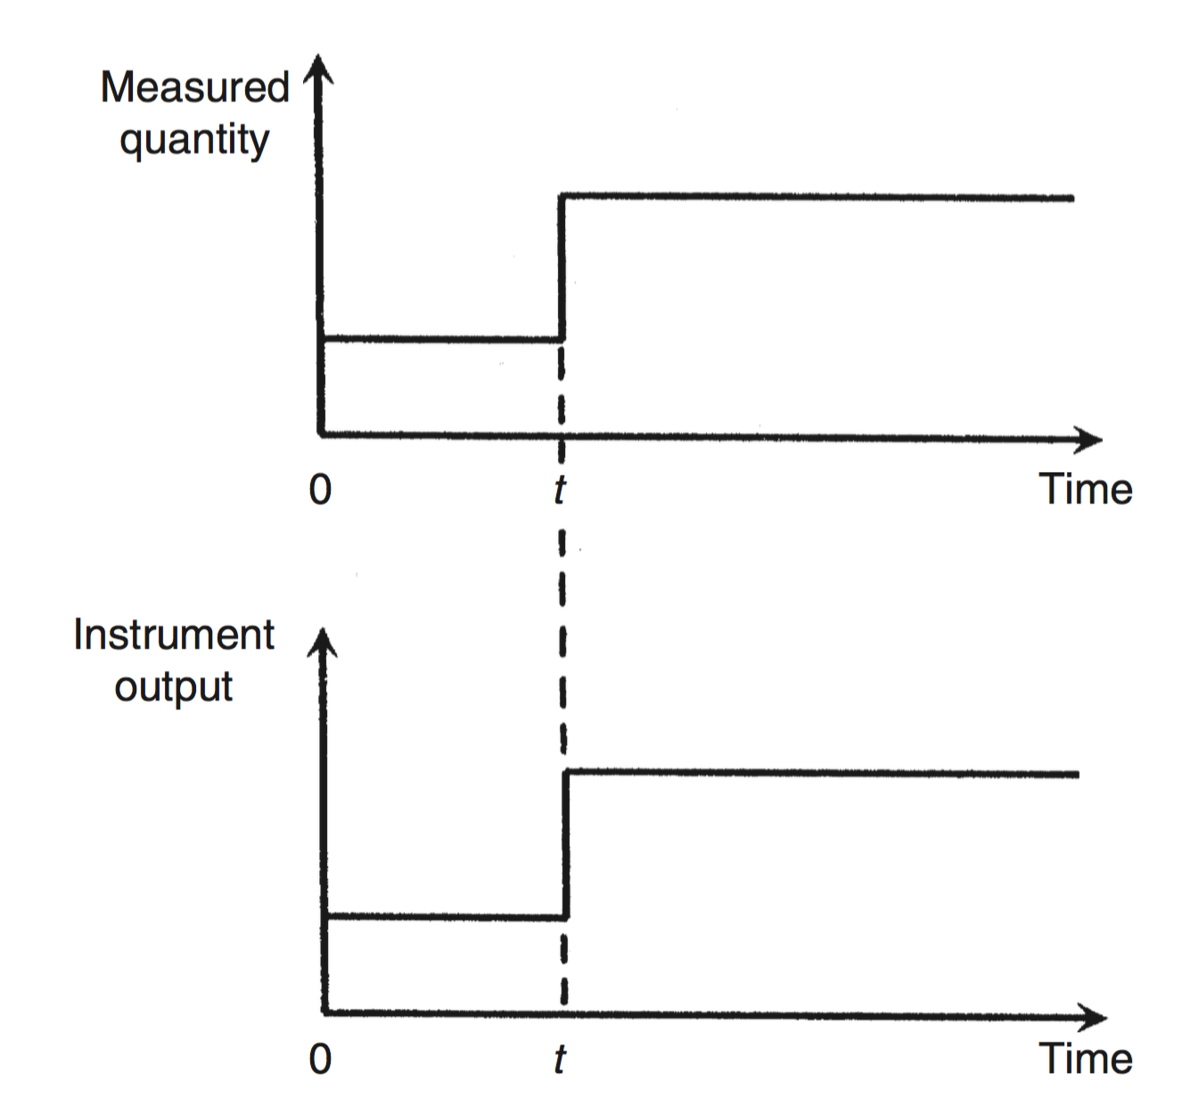
Dynamic Characteristics of Instruments
[Zero-Order Instrument]
Instruments with such dynamic characteristic are called Zero-Order Instrument
The output changes instantaneously in response to an input change
Instrument gives a static output in response to a static input.

Slide 51
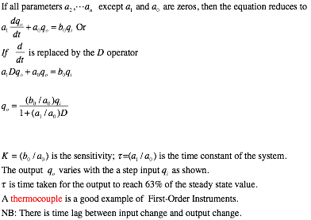
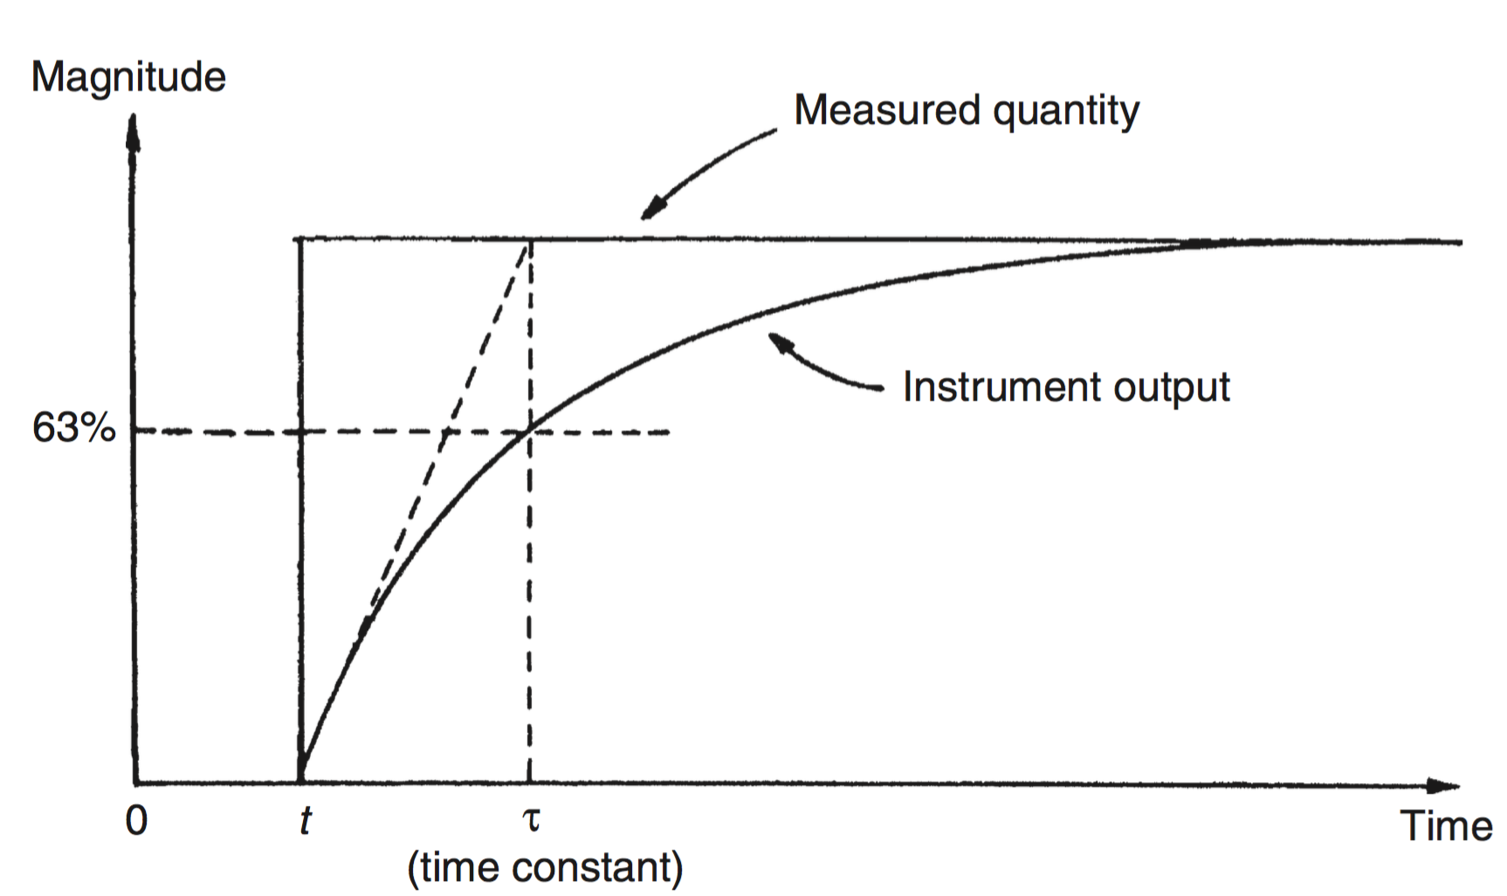
Dynamic Characteristics of Instruments
[First-Order Instrument]

Slide 52
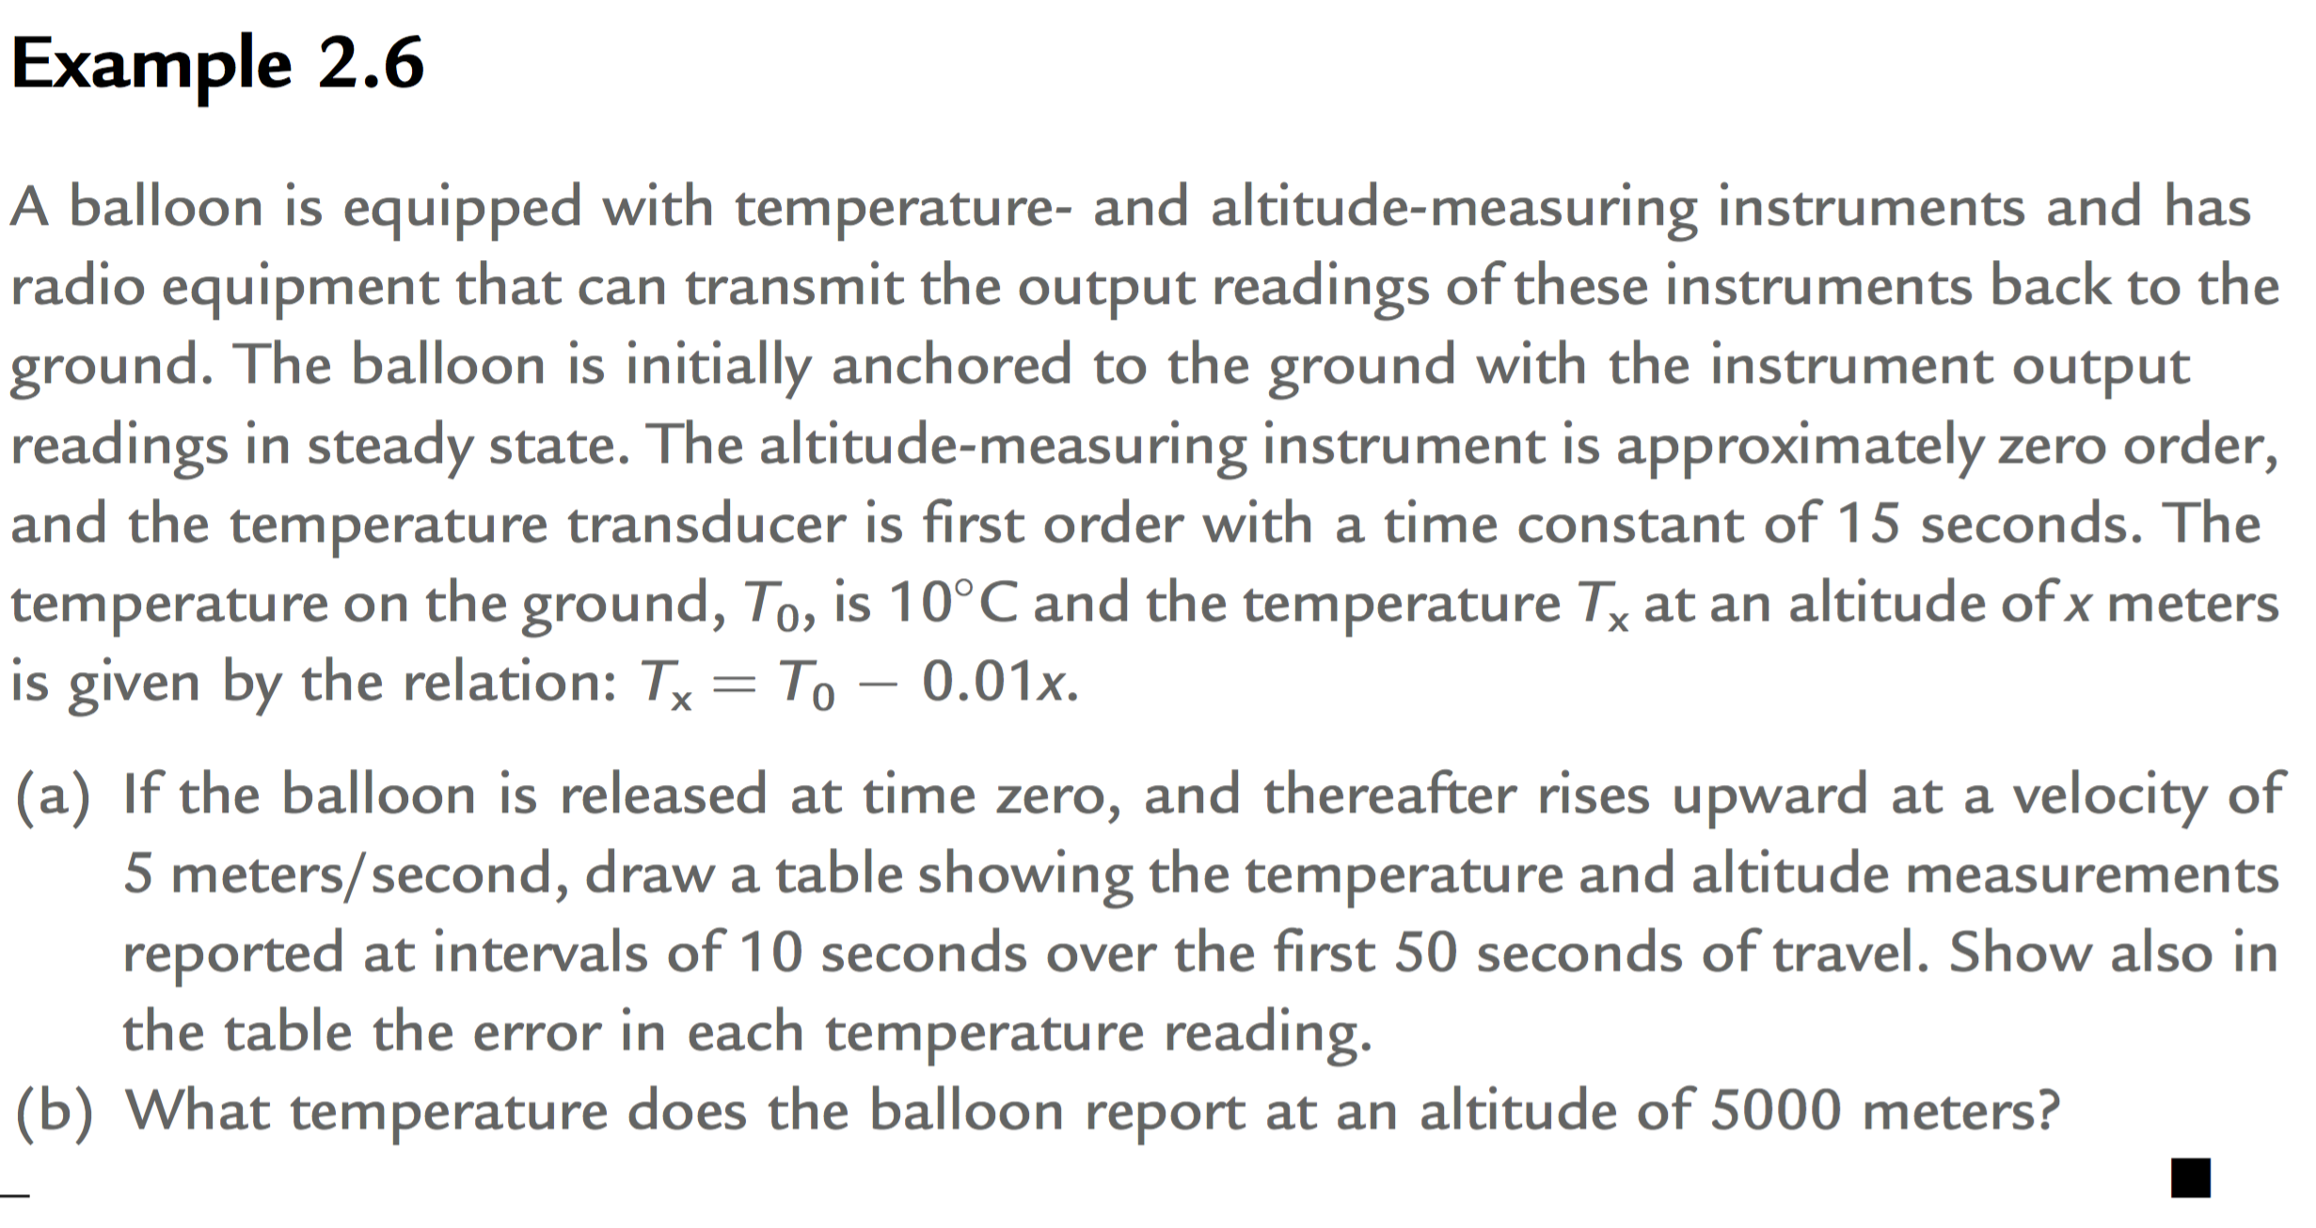
Dynamic Characteristics of Instruments
[Second-Order Instrument]

Slide 53
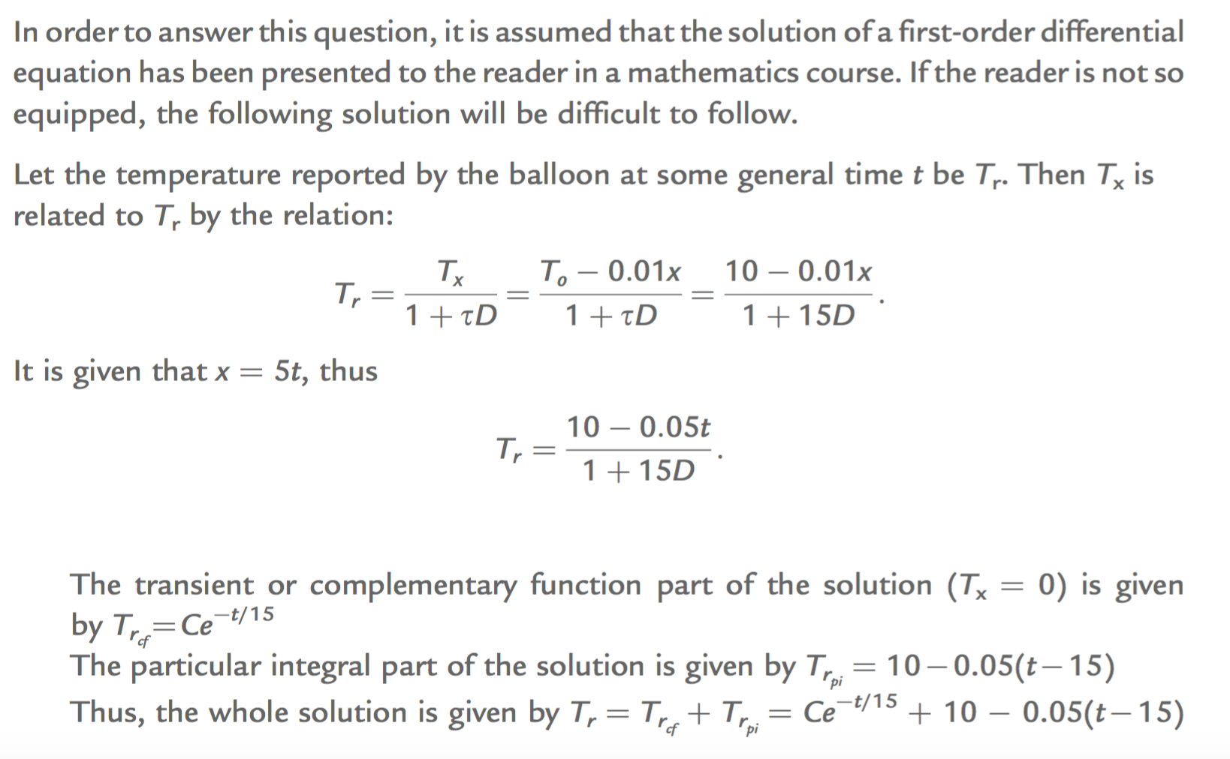
Dynamic Characteristics of Instruments
[Second-Order Instrument]

Slide 54
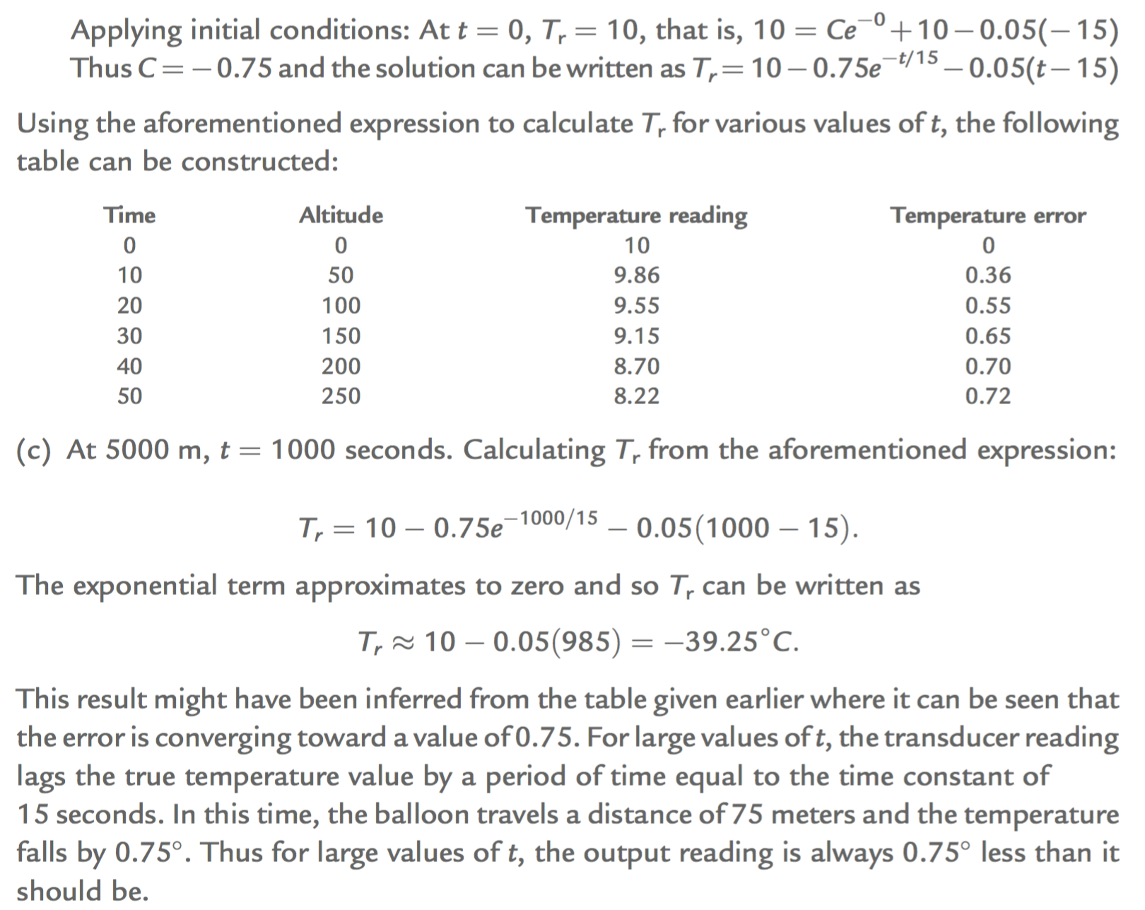
Dynamic Characteristics of Instruments
[Second-Order Instrument]

Slide 55
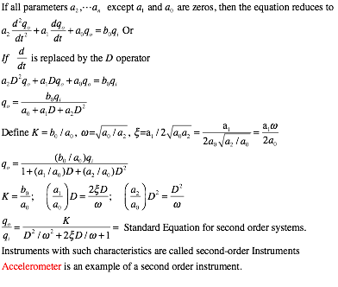
Dynamic Characteristics of Instruments
[Second-Order Instrument ]

Slide 56
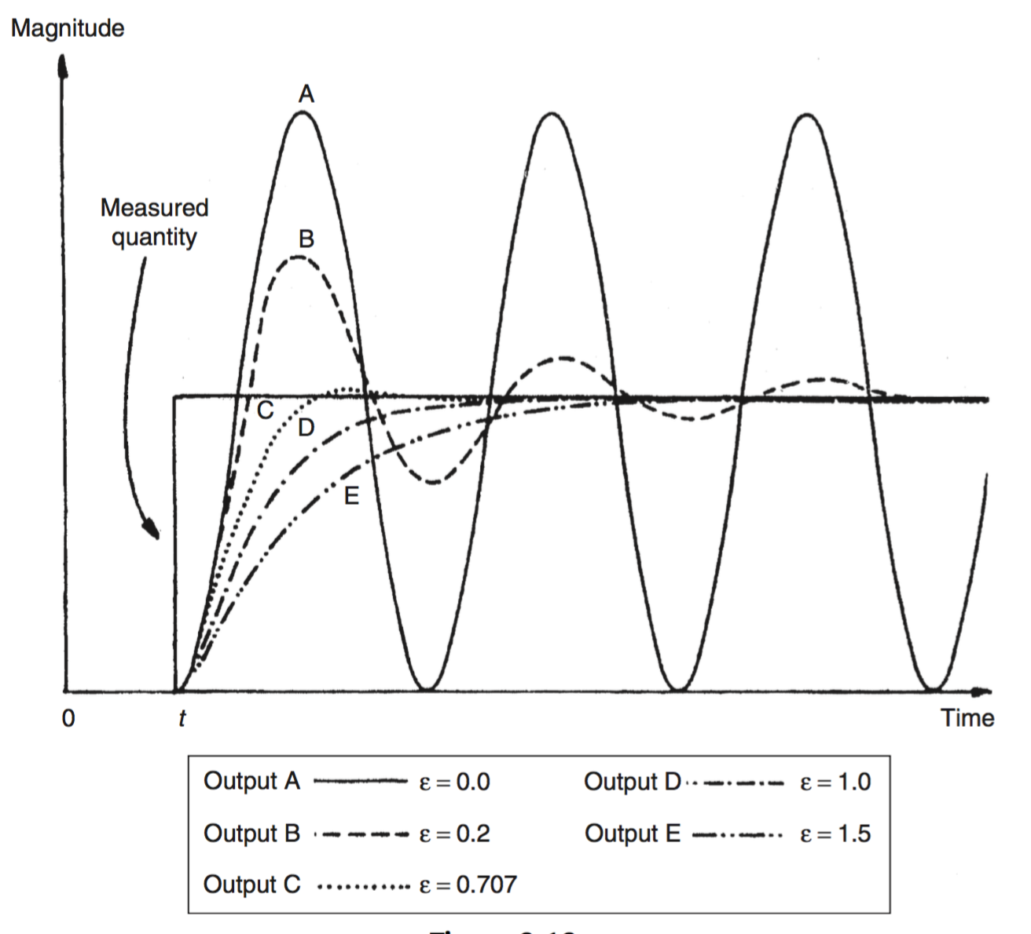
Dynamic Characteristics of Instruments
[Second-Order Instrument ]
Damping:
A: where ξ = 0 : No damping: Constant amplitude oscillations when disturbed by any change in the physical quantity measured.
B: light damping of ξ = 0.2, The response to a step change in input is still oscillatory but the oscillations die down gradually.
A further increase in the value of x reduces oscillations and overshoots still more, as shown by curves C and D
Finally the response becomes very overdamped, as shown by curve E, where the output reading creeps up slowly toward the correct reading.
The extreme response curves A and E are grossly unsuitable for any measuring instrument.
If an instrument were to be only ever subjected to step inputs, then the design strategy would be to aim toward a damping ratio of 0.707, which gives the critically damped response (C).
Unfortunately, most of the physical quantities that instruments are required to measure do not change in the mathematically convenient form of steps, but rather in the form of ramps of varying slopes.
Commercial Instruments generally have ξ from ξ = 0.6 to 0.8.

Slide 57
CALCULATION OF COMPLEX POWER
THANK YOU
AND
ALL THE BEST

Slide 58
Quiz 1 (Write only answers) – 5 Mins
Sensor | Mean (V) | Standard Deviation(V)
A | 3.44 | 0.4
B | 3.72 | 0.5
C | 2.84 | 0.33
D | 2.62 | 0.64
E | 3.33 | 0.22
F | 2.93 | 0.11
Five sensors, labelled A to F, were used to measure a D.C. voltage of 3V. Each measurement was repeated 1000 times and the mean and standard deviation of the measurements were taken. The table below shows the statistics for the individual sensors.
(a) Order the sensors in order of increasing accuracy.
(b) Order the sensors in order of increasing precision.

